Slide 1
E-dnevnik
Luka Ujević
Antonela Dragičević
Graziano Kaluža
Nikolina Gjergja

Slide 2

Dokumentacija
Korištenje (use-case diagram)
01
Aktivnosti (activity diagaram)
02
Podaci (ER diagram)
03
04
Klase (class diagram)
Objekti (sequence diagram)
05

Slide 3
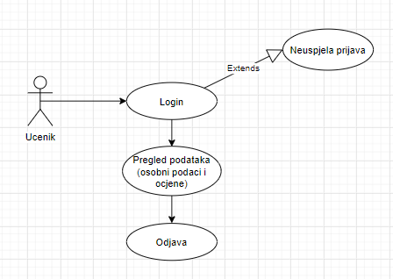
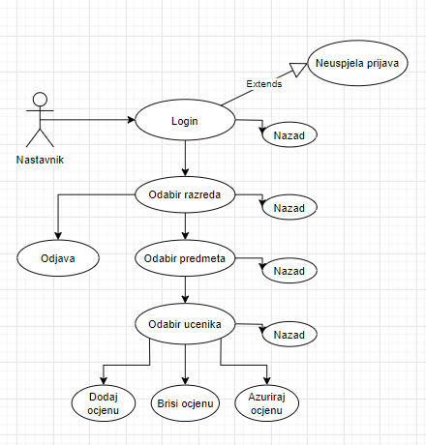
01
Use-case diagram
You could enter a subtitle here if you need it

Slide 4
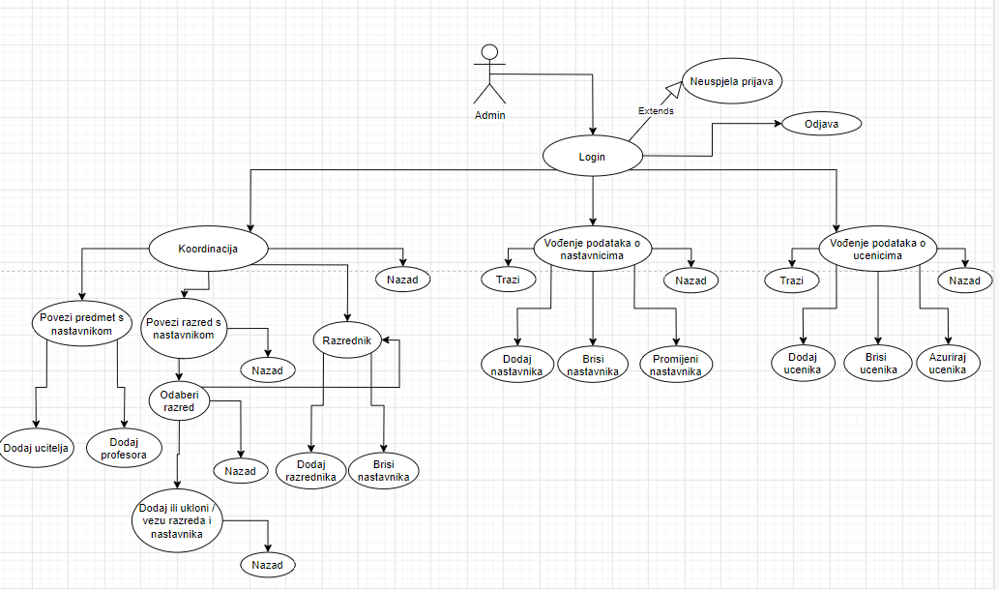

Slide 5
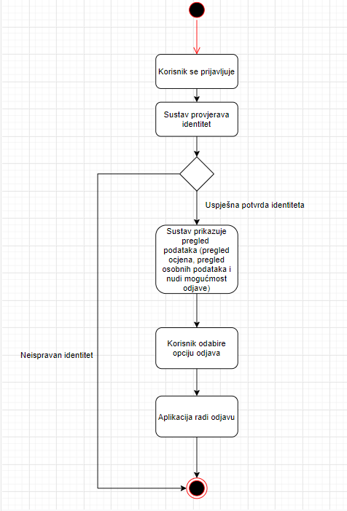
02
Activity diagram
Aktinost ucenika-pregled podataka

Slide 6
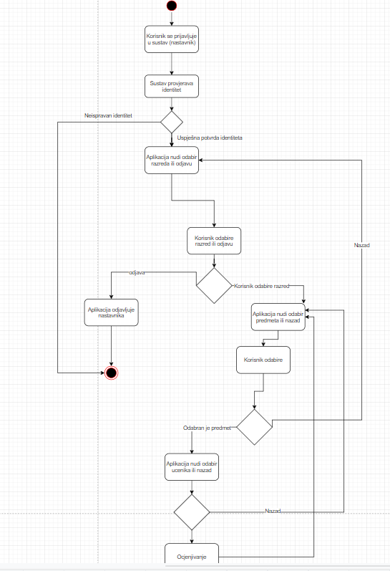
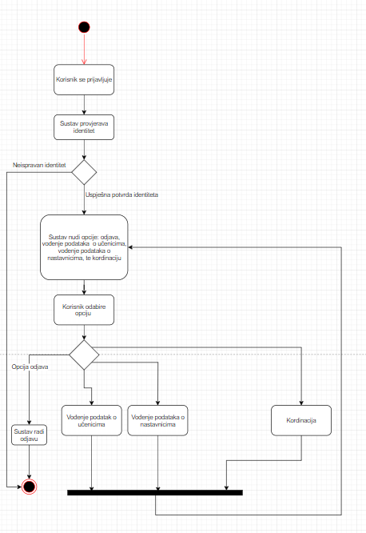


Activity…
SATURN
JUPITER
Nastavnik-odabir predmeta
Aktivnosti-administracija

Slide 7
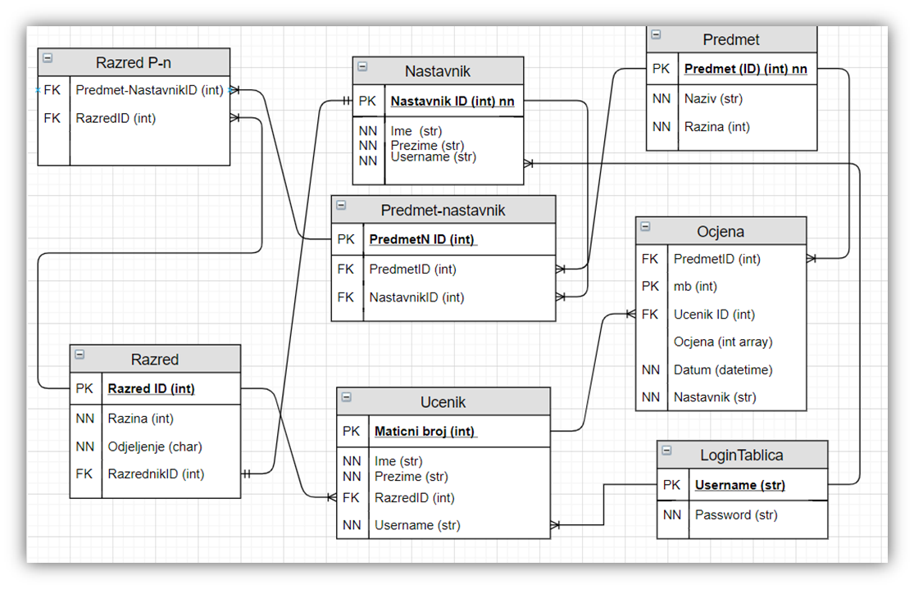

03
ER diagram

Slide 8

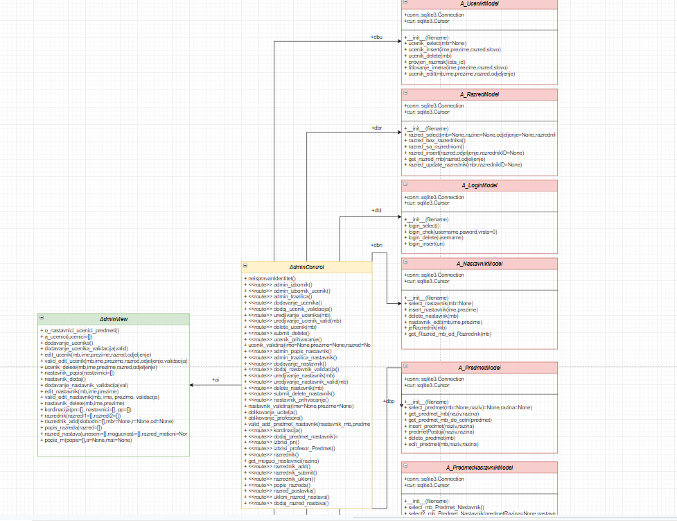
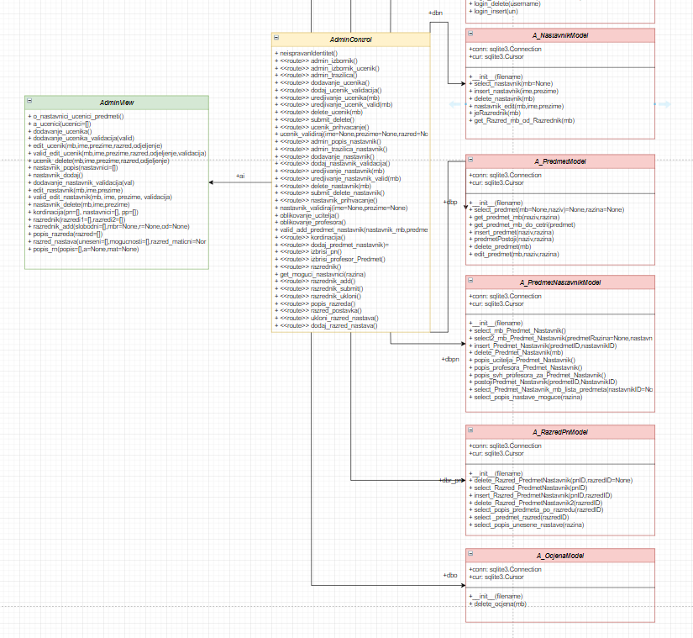
Class diagram
Admin
04
Mercury is the closest planet to the Sun
Venus has a beautiful name, but it’s terribly hot
It’s the biggest planet in our Solar System

Slide 9

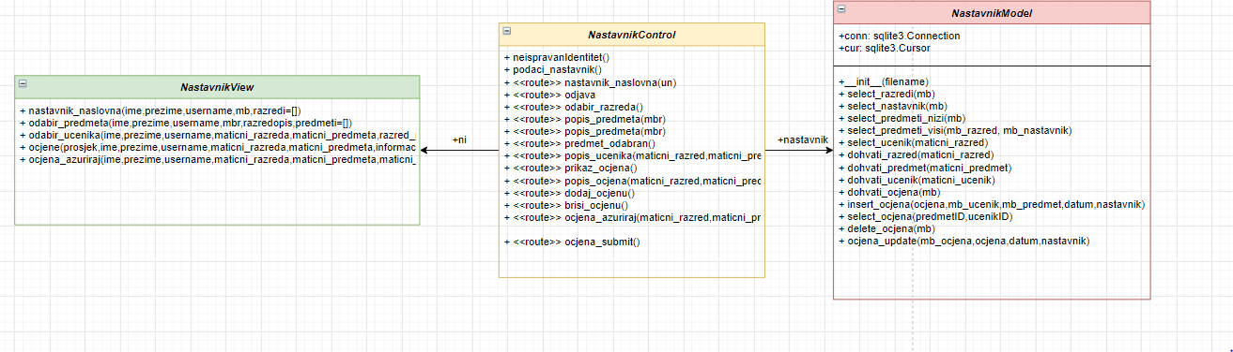
Nastavnik
View Control Model
”

Slide 10

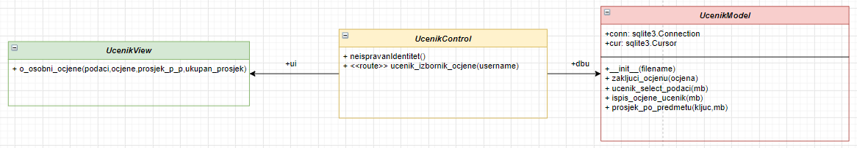
Učenik
View Control Model

Slide 11
Sequence diagram
05

Slide 12
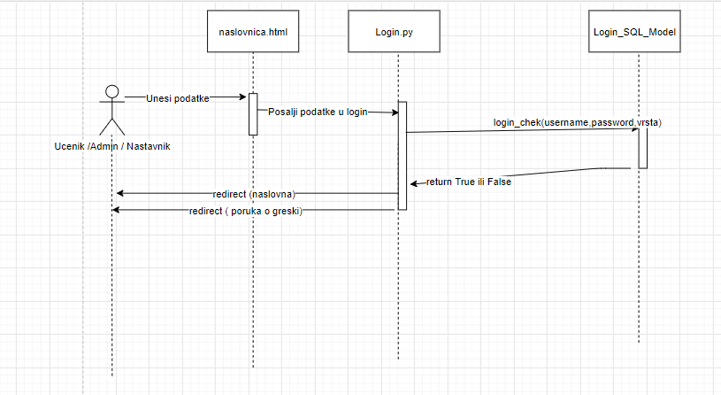
Login
This is the ringed planet. It’s composed of hydrogen and helium

Slide 13
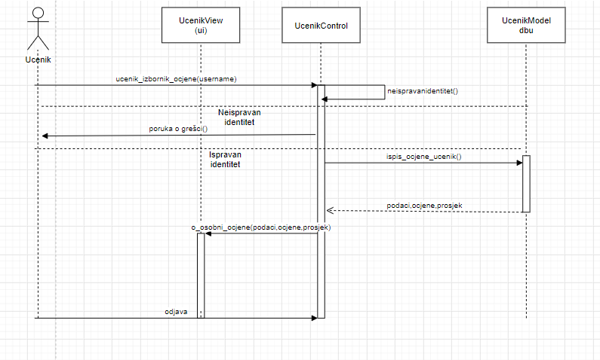
Učenik

Slide 14
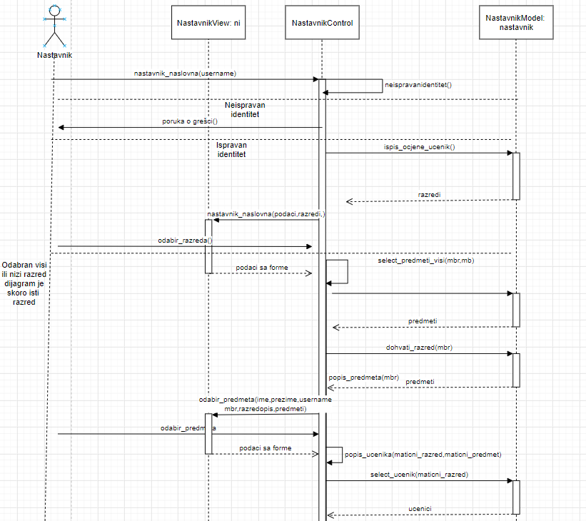
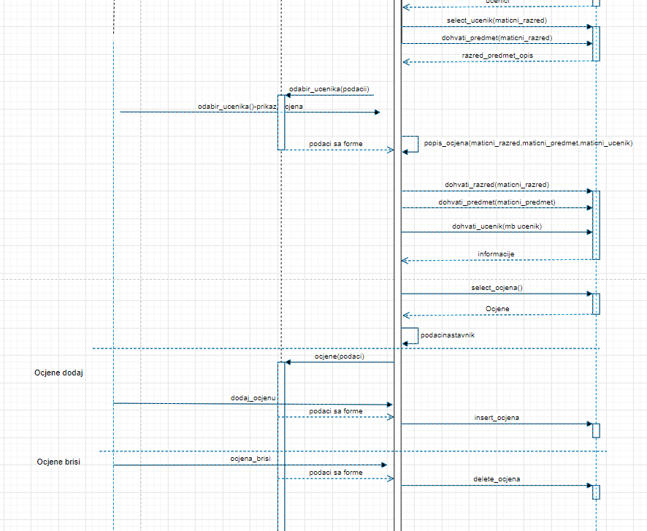
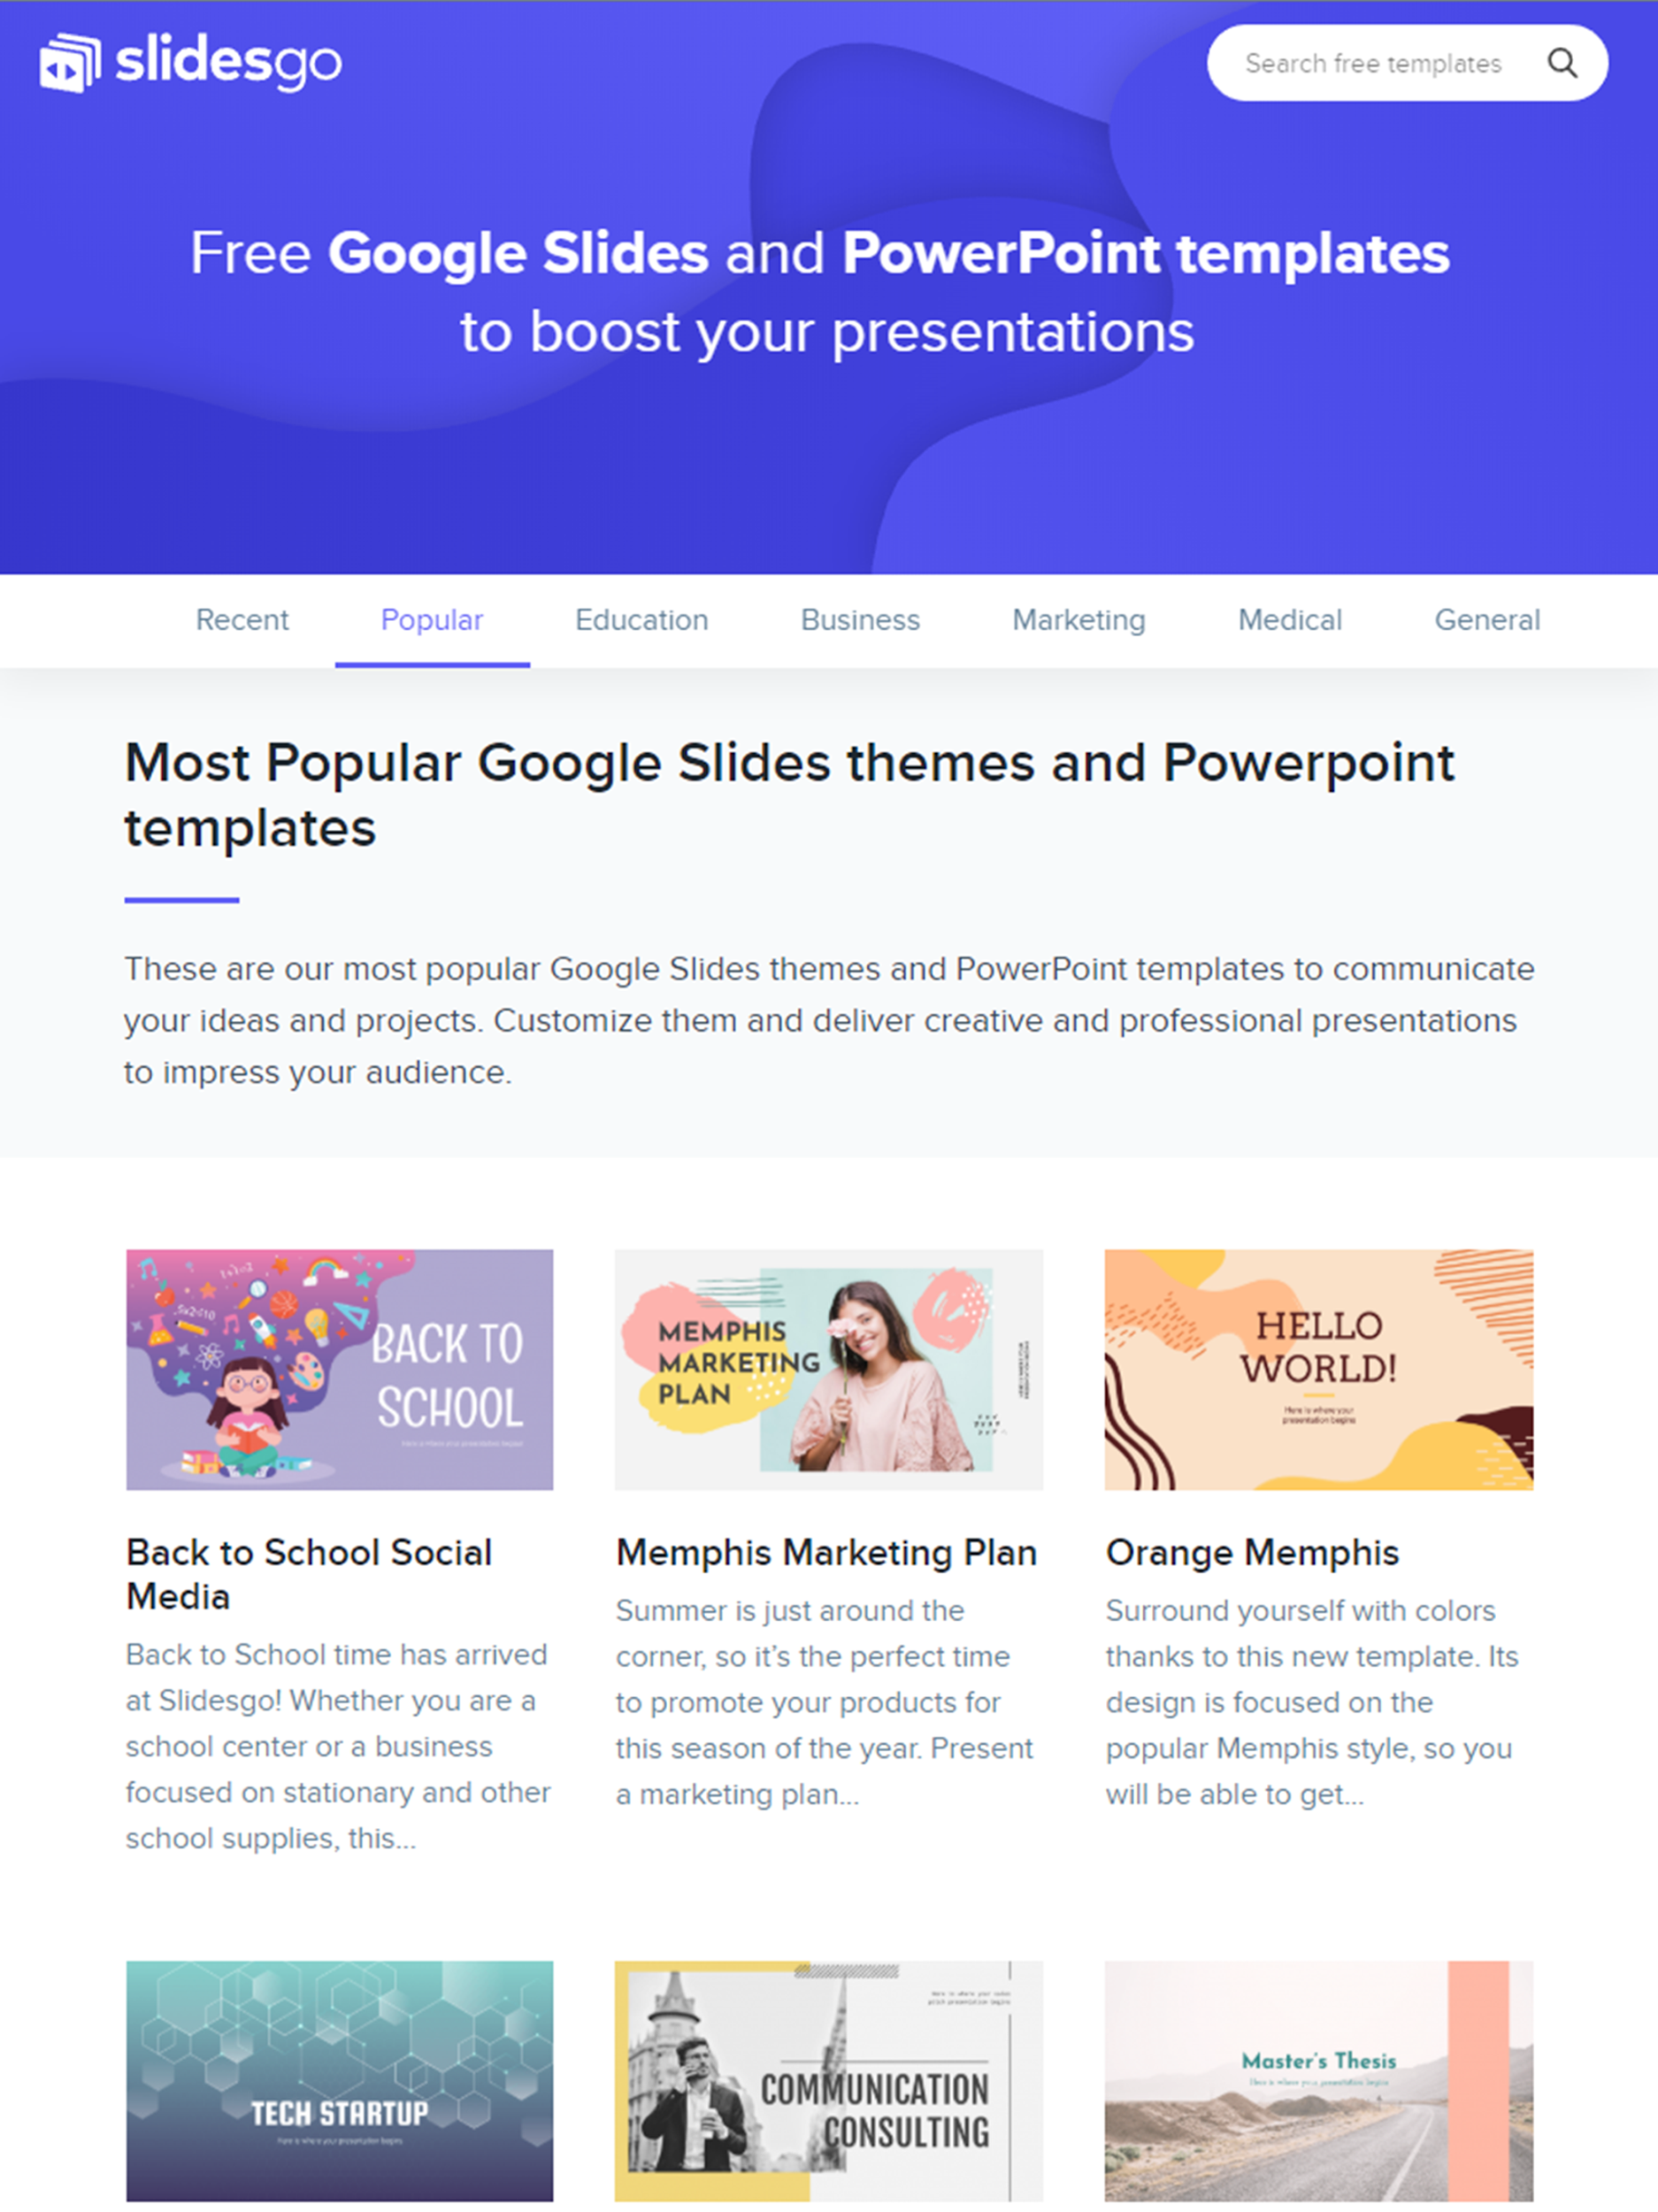
Nastavnik

Slide 15
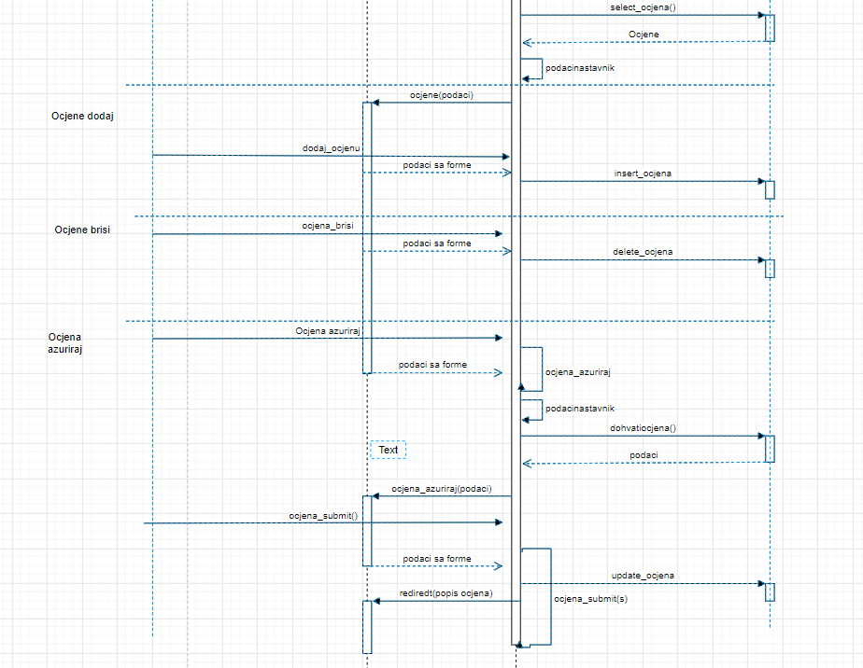

Slide 16
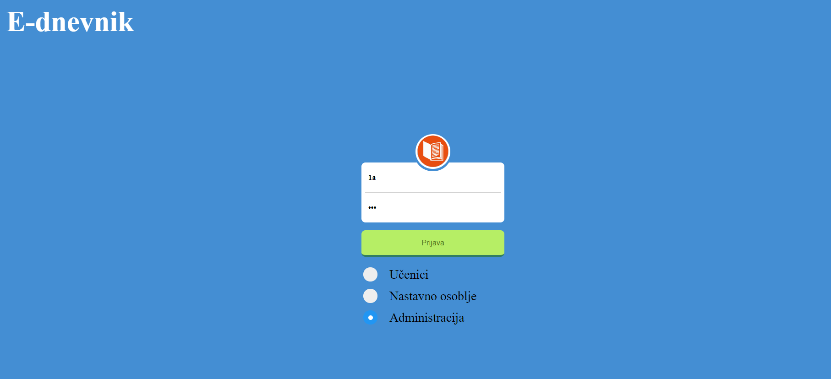
Aplikacija
-mogućnost prijave kao: –admin
-nastavnik
-učenik

Slide 17

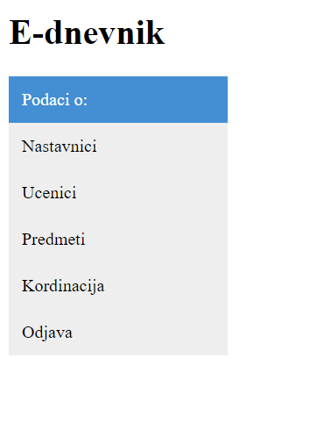

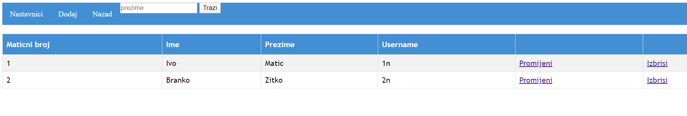
Admin

Slide 18

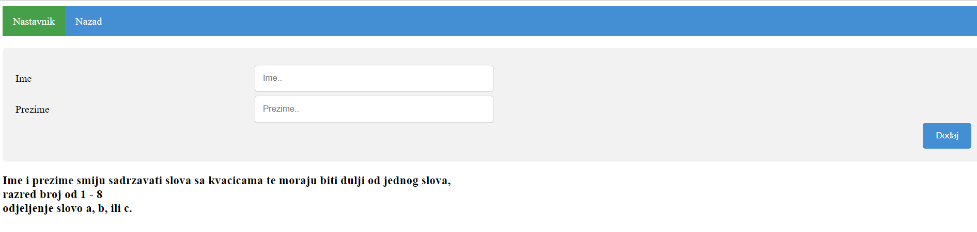

Slide 19
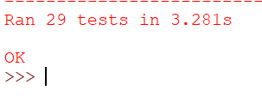
TESTIRANJE

Slide 20
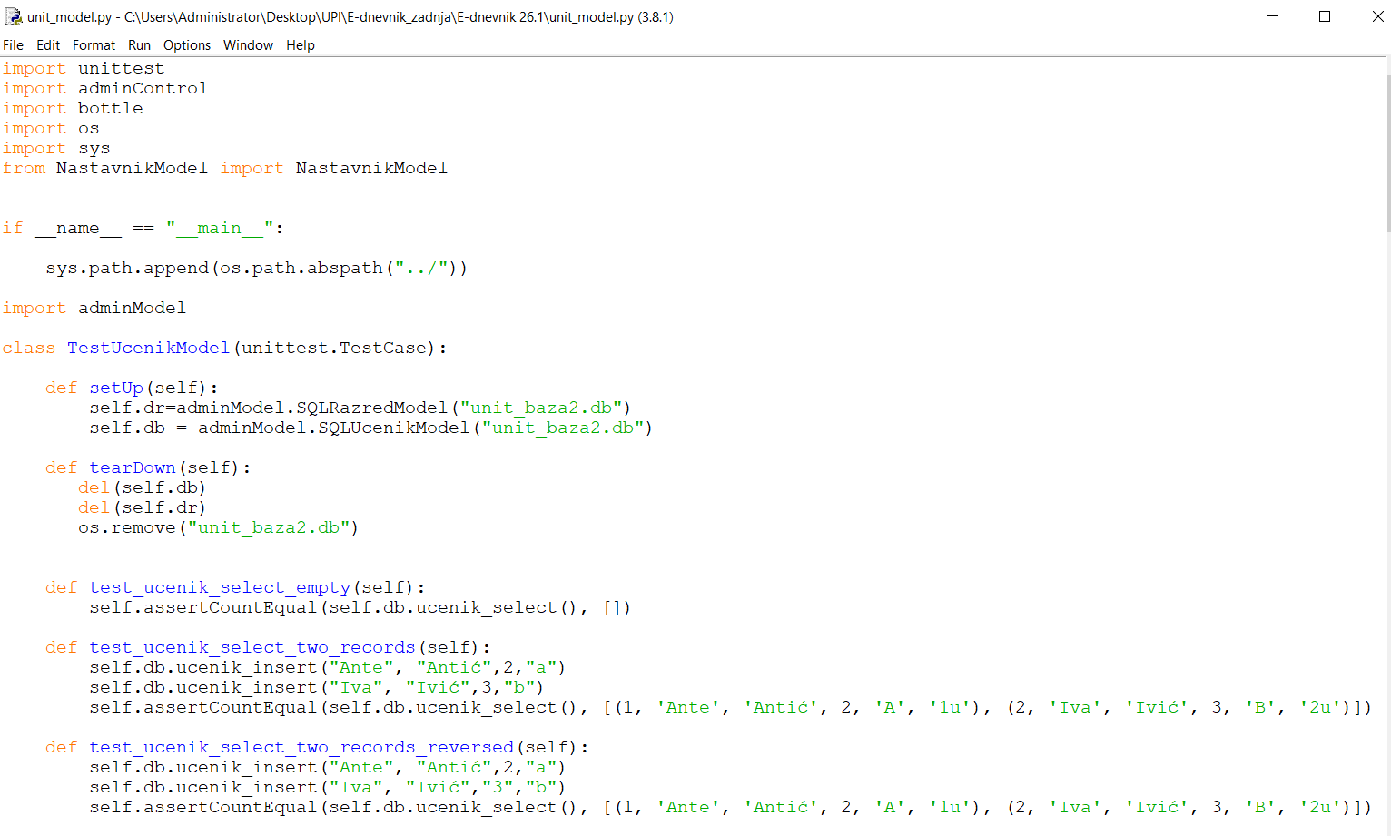
Ucenik
 | MASS (EARTHS) | SURFACE GRAVITY (EARTHS) | DIAMETER (EARTHS)
MARS | 100 | 355 | 370
MERCURY | 490 | 150 | 890
VENUS | 1,000 | 260 | 245

Slide 21
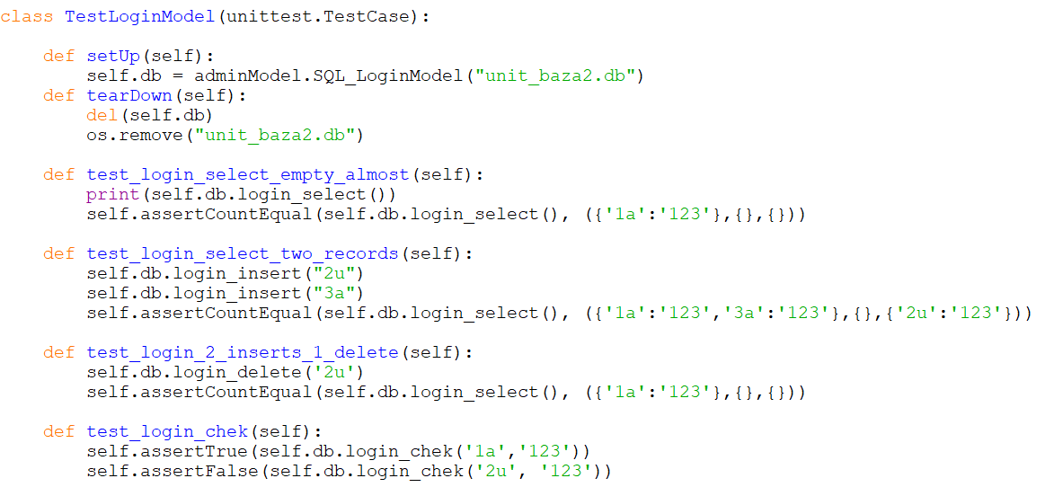
Login
Find out where all our colleges are located around the world

Slide 22
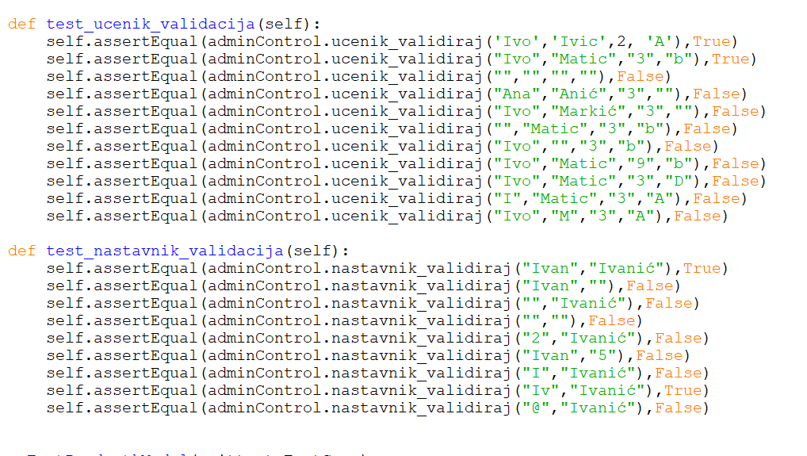
Validacija

Slide 23

Hvala na pažnji !

